Slide 1
Topic 3:
Experiments
STOR 155: Introduction to Data Models and Inference
Dr. Teressa Bergland
Fall 2025

Slide 2
Announcements
Course PSAs:
Reminder: Tutorial sessions start this week!
Homework 2 due TODAY, Tuesday 1/20 on WebAssign
  You likely can still complete this homework even if you have not yet paid for WebAssign… but if you haven’t yet, it’s time to do that.
Homework 3 due Thursday 1/22 on WebAssign
Attendance: If you are getting errors related to location, try accessing PollEverywhere a different way (different device, app vs browser, etc)

Slide 3
Let’s Practice! Choosing Sampling Methods
The native Yup’ik peoples of Alaska have seen an increase in chronic disease over the last several decades, despite little to no change to their traditional lifestyle. The problem is especially bad in rural and isolated areas.
You are investigating whether these diseases might stem from increased heavy metal concentrations in the traditional Yup’ik diet.
Your first step is to determine whether the Yup’ik have abnormally high concentrations of heavy metals in their blood.
A local expert informs you that there are approximately 60 rural Yup’ik villages in Alaska, ranging from 50-250 residents each.
How might you collect a sample from this population for your study?

Slide 4
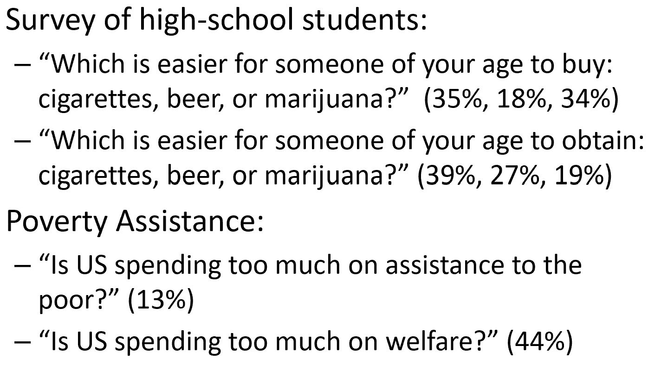
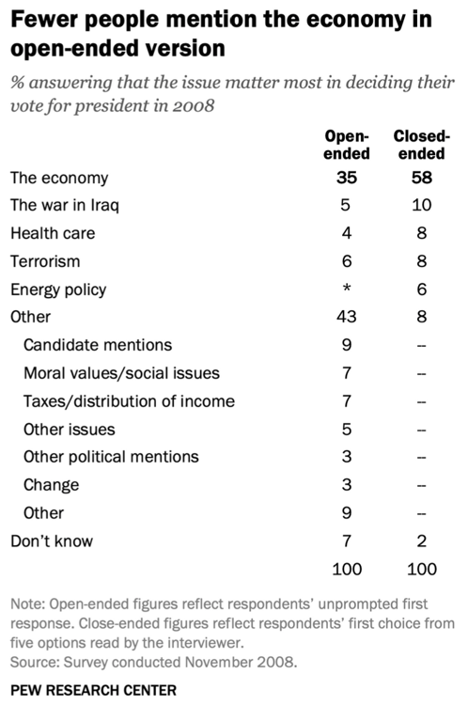
Additional Factors in Causing Bias
Wording
Framing

Slide 5
Sample statistic, Population parameter
Populations have parameters (unknown true values of interest)
Samples have statistics (observed values from sample)
Goal: a good, unbiased sample has statistics that are good estimates of parameters

Slide 6
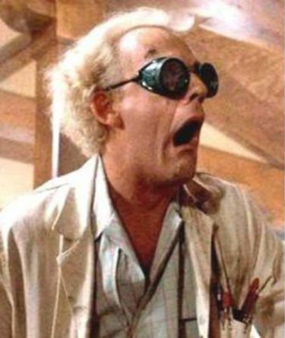

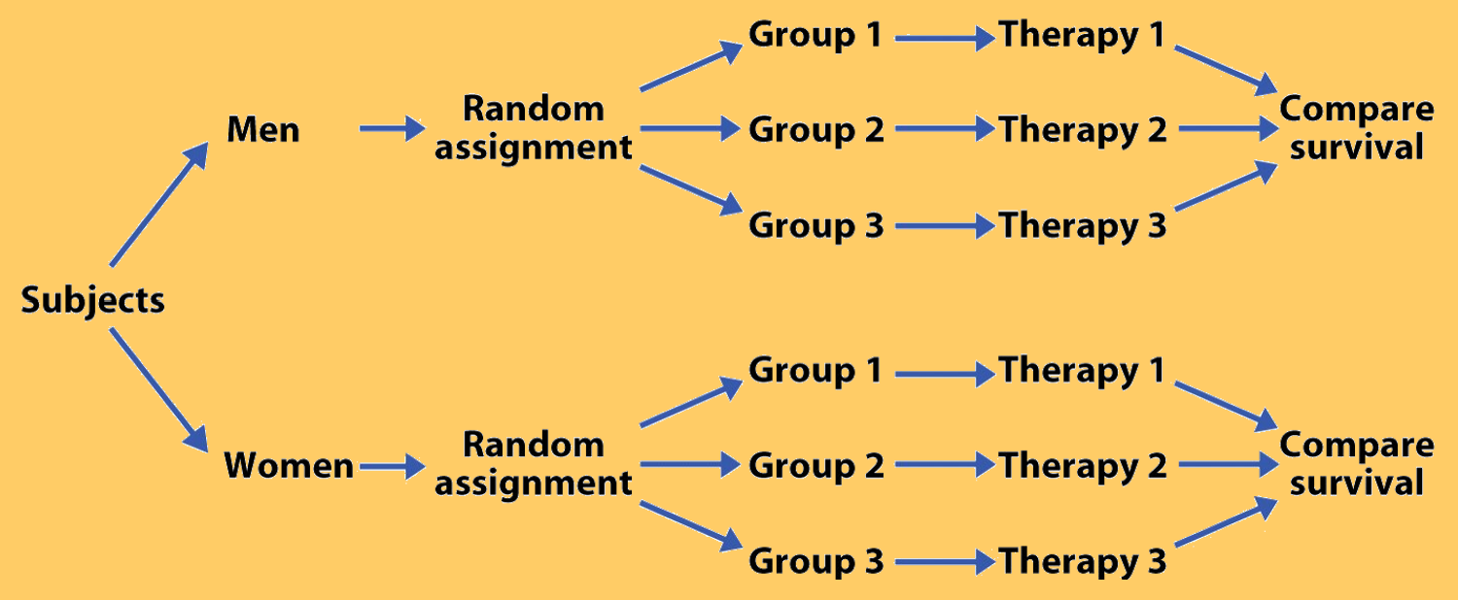
Experimental Design
4 Principles of Experimental Design:
Control
Randomize
Replicate
Block

Slide 7
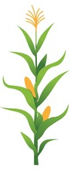
Let’s Practice! Variables
A study is designed to test the effect of light level and air quality on the growth rate of corn. The researcher also believes that light level and air quality might have different effects on corn grown in soil with different acidity levels, so wants to make sure varying soil acidity levels are equally represented in each group.
There are 3 explanatory variables (light, air, soil) and 1 response variable (corn growth)
There are 2 explanatory variables (light and air), 1 blocking variable (soil), and 1 response variable (corn growth)
There is 1 explanatory variable (soil) and 3 response variables (light, air, corn growth)
There are 2 blocking variables (light and air), 1 explanatory variable (soil), and 1 response variable (corn growth)

Slide 8
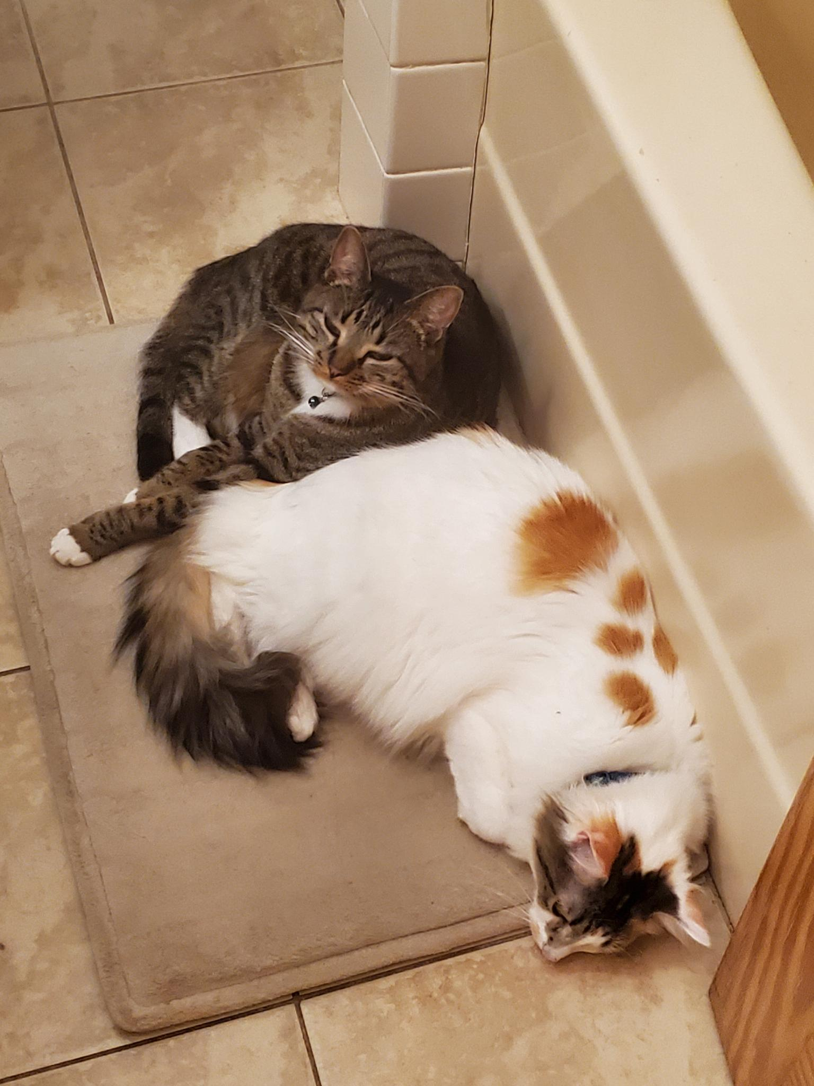
Eliminating Bias
Important terms:
Placebo
Placebo effect
Blinding
Double-blind

Slide 9
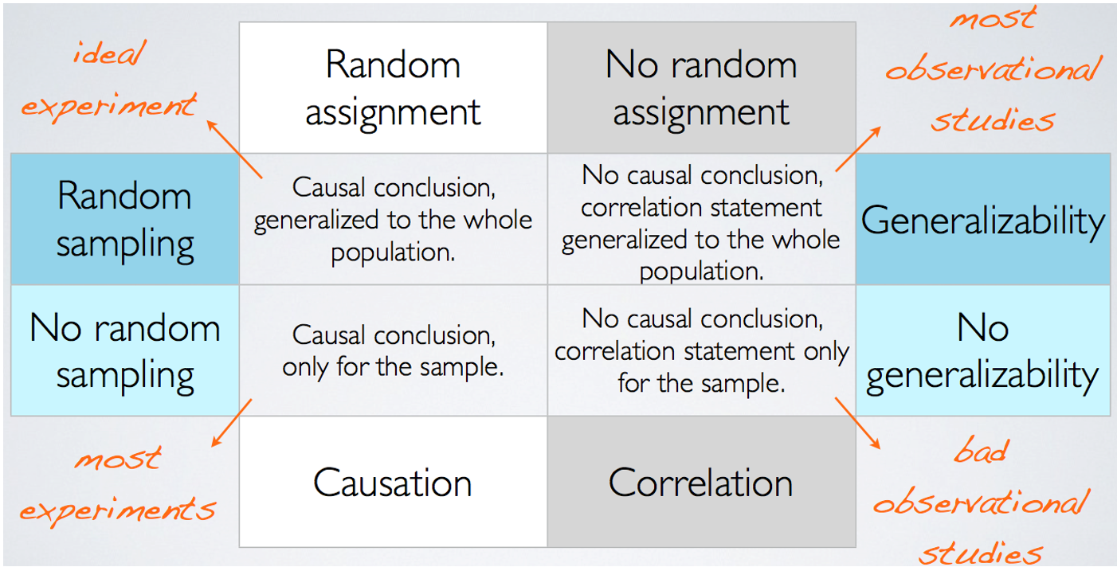
Experiments vs. Observational Studies

Slide 10
Practice Time! Experimental True/False
Which of the following statements regarding differences between experiments and observational studies are true?
Experiments take place in a lab, while observational studies do not need to.
In an observational study we only look at what happened in the past.
Experiments use random assignment while observational studies do not.
Observational studies are completely useless since no causal inference can be made based on their findings.
Experiments involve active intervention or treatment, while observational studies are passive.

